Slide 1



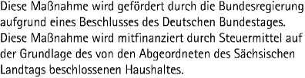
CENTER FOR SCALABLE DATA ANALYTICS AND ARTIFICIAL INTELLIGENCE
NLP-KI-Seminar 2025
Robert Haase
https://github.com/ScaDS/NLP-KI-Seminar-2025/

Slide 2
NLP KI Seminar
Durch aktive Teilnahme am Seminarmodul „NLP-KI“ erlangen die Studierenden einen guten Überblick über aktuelle Techniken des Prompt-Engineering zur Verarbeitung natürlicher Sprache. Sie sind dann darüber hinaus in der Lage, die wichtigsten Inhalte wissenschaftlicher Veröffentlichungen zu identifizieren, zusammenzufassen und verständlich zu erklären. Sie können diese Inhalte in Form einer wissenschaftlichen Arbeit niederschreiben, die den formellen Anforderungen einer Konferenz entsprechen würde. Außerdem können sie die Inhalte in einem wissenschaftlichen Vortrag präsentieren. Die Studierenden sind in der Lage, die Inhalte wissenschaftlicher Texte kritisch zu hinterfragen und mit anderen Studierenden zu diskutieren.
Through active participation in the seminar module "NLP-AI", students gain a solid overview of current prompt engineering techniques for natural language processing. Furthermore, they are able to identify, summarize, and clearly explain the key content of scientific publications. They can write this content in the form of a scientific paper that meets the formal requirements of a conference. In addition, they are capable of presenting the content in a scientific talk. Students are also able to critically reflect on the content of scientific texts and discuss it with their peers.
25-30 min presentation + 15 min questions / discussion
About 5 pages excluding title page and references

Slide 3
Presenting a scientific topic
Have a red line of the story
Outline:
Background (25-33%)
Methods / experiments (25-33%)
Results / discussion (25-33%)
Blow audience away with amazing related stuff (< 5%)
Use professional language
Explain Figures well
If you used Generative AI, disclose for what and how you used it.
> 50% of the written words must be done without Generative AI.

Slide 4
Presenting a scientific topic
Grade for
the presentation
Topic well explained
Cited sources properly
Stay in time (25-30 min)
Questions answered correctly
written part
Slides in PDF format
about 5 pages (including additional research / answers) in PDF-format
12.5% of the grade each
Must be in the same language: English or German
25% of the grade each

Slide 5
Registration
You register for up to five potential topics. First come, first serve. Maximum 22 students.
Registration: April 14th, 0:00 – 23:59 CEST to:
robert.haase@uni-leipzig.de
Examples:
7:03:20
Dear Dr. Haase,
I would like to present any one of these:
2203.17274v2
2005.14165v4
2311.09277v1
Best,
A
7:03:22
Dear Dr. Haase,
I would like to present and one of these:
2203.17274v2
2005.14165v4
2311.09277v1
Best,
B
12:00:00
Dear Dr. Haase,
I would like to present any one of these:
2203.17274v2
2005.14165v4
2311.09277v1
Best,
C
First has the free choice, but A. has to give talk April 25th.
Second cannot choose same paper. B. presents April 25th.
10th student gives 10th talk (Mid May).

Slide 6

Registration
Announcement of chosen topics before April 15th 23:59:00
https://github.com/ScaDS/NLP-KI-Seminar-2025

Slide 7
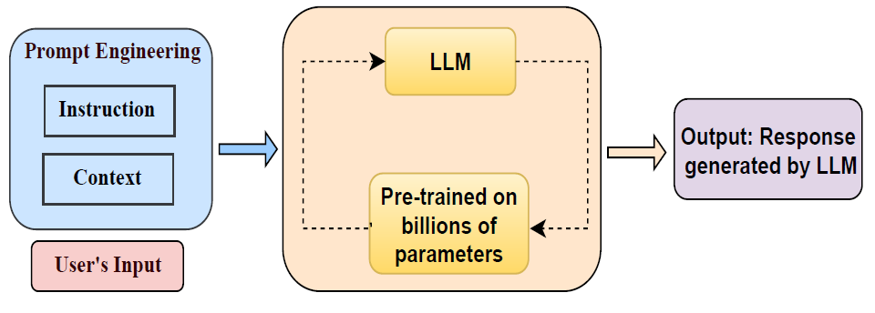
Topic
Large Language Models for Natural Language Processing / Prompt Engineering
Source: Sahoo et al (2024), licensed CC-BY 4.0
http://arxiv.org/abs/2402.07927v2

Slide 8
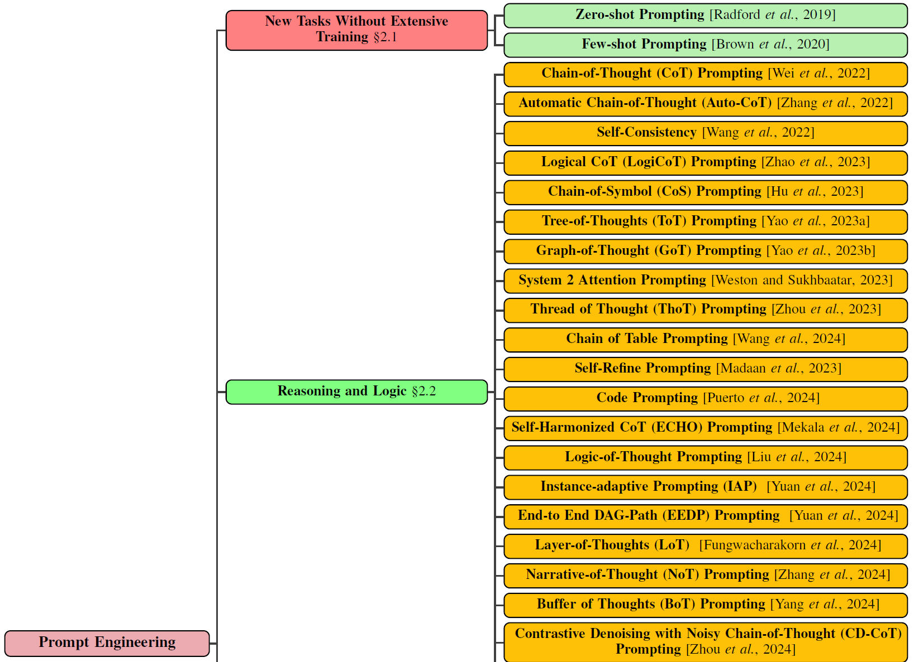
Topic
Large Language Models for Natural Language Processing / Prompt Engineering
Source: Sahoo et al (2024), licensed CC-BY 4.0
http://arxiv.org/abs/2402.07927v2

Slide 9
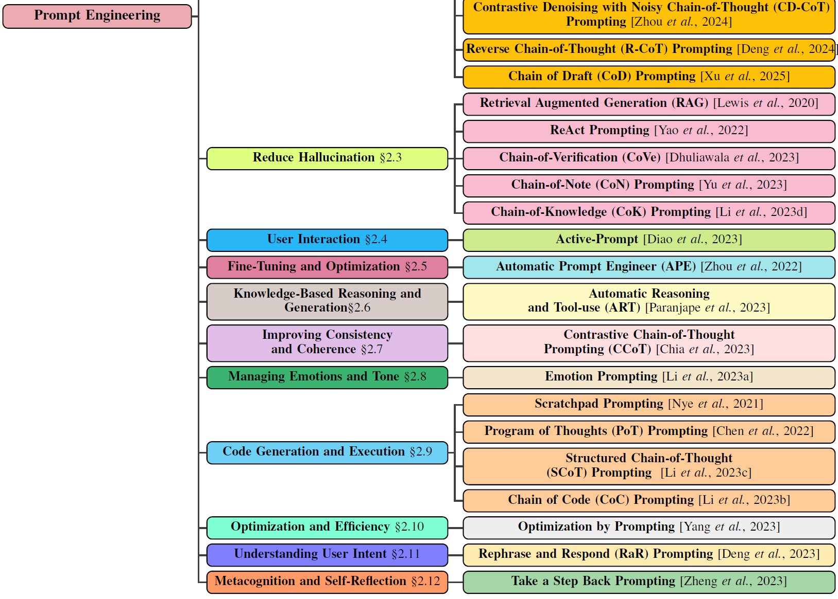
Topic
Large Language Models for Natural Language Processing / Prompt Engineering
Source: Sahoo et al (2024), licensed CC-BY 4.0
http://arxiv.org/abs/2402.07927v2

Slide 10
Available Topics
Hyojin Bahng et al. 'Exploring Visual Prompts for Adapting Large-Scale Models' https://arxiv.org/abs/2203.17274v2
Tom B. Brown et al. 'Language Models are Few-Shot Learners' https://arxiv.org/abs/2005.14165v4
Wenhu Chen et al. 'Program of Thoughts Prompting: Disentangling Computation from Reasoning for Numerical Reasoning Tasks' https://arxiv.org/abs/2211.12588v4
Yew Ken Chia et al. 'Contrastive Chain-of-Thought Prompting' https://arxiv.org/abs/2311.09277v1
Yihe Deng et al. 'Rephrase and Respond: Let Large Language Models Ask Better Questions for Themselves' https://arxiv.org/abs/2311.04205v2
Linger Deng et al. 'R-CoT: Reverse Chain-of-Thought Problem Generation for Geometric Reasoning in Large Multimodal Models' https://arxiv.org/abs/2410.17885v2
Shehzaad Dhuliawala et al. 'Chain-of-Verification Reduces Hallucination in Large Language Models' https://arxiv.org/abs/2309.11495v2
Shizhe Diao et al. 'Active Prompting with Chain-of-Thought for Large Language Models' https://arxiv.org/abs/2302.12246v5
Wachara Fungwacharakorn et al. 'Layer-of-Thoughts Prompting (LoT): Leveraging LLM-Based Retrieval with Constraint Hierarchies' https://arxiv.org/abs/2410.12153v1
Hanxu Hu et al. 'Chain-of-Symbol Prompting Elicits Planning in Large Langauge Models' https://arxiv.org/abs/2305.10276v7
Patrick Lewis et al. 'Retrieval-Augmented Generation for Knowledge-Intensive NLP Tasks' https://arxiv.org/abs/2005.11401v4
Cheng Li et al. 'Large Language Models Understand and Can be Enhanced by Emotional Stimuli' https://arxiv.org/abs/2307.11760v7
Chengshu Li et al. 'Chain of Code: Reasoning with a Language Model-Augmented Code Emulator' https://arxiv.org/abs/2312.04474v4
Jia Li et al. 'Structured Chain-of-Thought Prompting for Code Generation' https://arxiv.org/abs/2305.06599v3
Xingxuan Li et al. 'Chain-of-Knowledge: Grounding Large Language Models via Dynamic Knowledge Adapting over Heterogeneous Sources' https://arxiv.org/abs/2305.13269v4
Tongxuan Liu et al. 'Logic-of-Thought: Injecting Logic into Contexts for Full Reasoning in Large Language Models' https://arxiv.org/abs/2409.17539v2
Jieyi Long et al. 'Large Language Model Guided Tree-of-Thought' https://arxiv.org/abs/2305.08291v1
Aman Madaan et al. 'Self-Refine: Iterative Refinement with Self-Feedback' https://arxiv.org/abs/2303.17651v2
Rajasekhar Reddy Mekala et al. 'EchoPrompt: Instructing the Model to Rephrase Queries for Improved In-context Learning' https://arxiv.org/abs/2309.10687v3
Maxwell Nye et al. 'Show Your Work: Scratchpads for Intermediate Computation with Language Models' https://arxiv.org/abs/2112.00114v1

Slide 11
Available Topics
Bhargavi Paranjape et al. 'ART: Automatic multi-step reasoning and tool-use for large language models' https://arxiv.org/abs/2303.09014v1
Haritz Puerto et al. 'Code Prompting Elicits Conditional Reasoning Abilities in Text+Code LLMs' https://arxiv.org/abs/2401.10065v3
Xuezhi Wang et al. 'Self-Consistency Improves Chain of Thought Reasoning in Language Models' https://arxiv.org/abs/2203.11171v4
Zilong Wang et al. 'Chain-of-Table: Evolving Tables in the Reasoning Chain for Table Understanding' https://arxiv.org/abs/2401.04398v2
Jason Wei et al. 'Chain-of-Thought Prompting Elicits Reasoning in Large Language Models' https://arxiv.org/abs/2201.11903v6
Jason Weston et al. 'System 2 Attention (is something you might need too)' https://arxiv.org/abs/2311.11829v1
Silei Xu et al. 'Chain of Draft: Thinking Faster by Writing Less' https://arxiv.org/abs/2502.18600v2
Chengrun Yang et al. 'Large Language Models as Optimizers' https://arxiv.org/abs/2309.03409v3
Ling Yang et al. 'Buffer of Thoughts: Thought-Augmented Reasoning with Large Language Models' https://arxiv.org/abs/2406.04271v2
Shunyu Yao et al. 'ReAct: Synergizing Reasoning and Acting in Language Models' https://arxiv.org/abs/2210.03629v3
Shunyu Yao et al. 'Tree of Thoughts: Deliberate Problem Solving with Large Language Models' https://arxiv.org/abs/2305.10601v2
Yao Yao et al. 'Beyond Chain-of-Thought, Effective Graph-of-Thought Reasoning in Language Models' https://arxiv.org/abs/2305.16582v2
Wenhao Yu et al. 'Chain-of-Note: Enhancing Robustness in Retrieval-Augmented Language Models' https://arxiv.org/abs/2311.09210v2
Xiaosong Yuan et al. 'Instance-adaptive Zero-shot Chain-of-Thought Prompting' https://arxiv.org/abs/2409.20441v3
Zhuosheng Zhang et al. 'Automatic Chain of Thought Prompting in Large Language Models' https://arxiv.org/abs/2210.03493v1
Xinliang Frederick Zhang et al. 'Narrative-of-Thought: Improving Temporal Reasoning of Large Language Models via Recounted Narratives' https://arxiv.org/abs/2410.05558v2
Xufeng Zhao et al. 'Enhancing Zero-Shot Chain-of-Thought Reasoning in Large Language Models through Logic' https://arxiv.org/abs/2309.13339v4
Huaixiu Steven Zheng et al. 'Take a Step Back: Evoking Reasoning via Abstraction in Large Language Models' https://arxiv.org/abs/2310.06117v2
Yongchao Zhou et al. 'Large Language Models Are Human-Level Prompt Engineers' https://arxiv.org/abs/2211.01910v2
Yucheng Zhou et al. 'Thread of Thought Unraveling Chaotic Contexts' https://arxiv.org/abs/2311.08734v1
Zhanke Zhou et al. 'Can Language Models Perform Robust Reasoning in Chain-of-thought Prompting with Noisy Rationales?' https://arxiv.org/abs/2410.23856v1

Slide 12
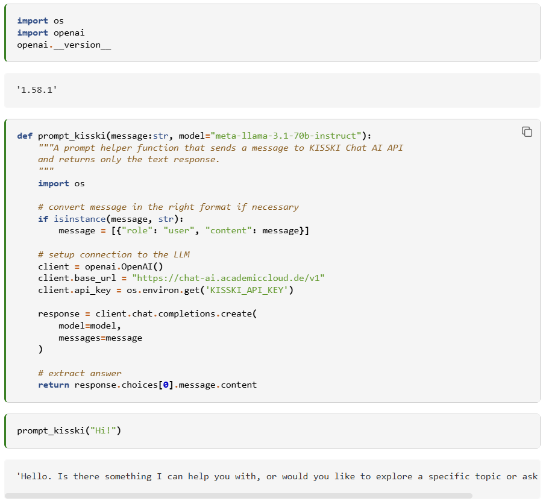
Optional: run you own experiments
You can use open-weight LLMs for free if you would like to run your own experiments within the scope of the paper you present (optional!).
LLM Service providers
Blablador: https://sdlaml.pages.jsc.fz-juelich.de/ai/guides/blablador_api_access/
KISSKI: https://kisski.gwdg.de/leistungen/2-02-llm-service/
https://scads.github.io/generative-ai-notebooks/15_endpoint_apis/06_kisski_endpoint.html

Slide 13
Schedule
 | Speaker 1 | Speaker 2
11.4.2025 | R. Haase | R. Haase
18.4.2025 | Good Friday
25.4.2025
2.5.2025
9.5.2025
16.5.2025
23.5.2025
30.5.2025
6.6.2025
13.6.2025
20.6.2025
27.6.2025
4.7.2025
11.7.2025
Fridays 13:15-14:45
SG 314

Slide 14
Deadlines
Talk topic registration period: April 14th, 0:00 – 23:59 CEST to: robert.haase@uni-leipzig.de
Written report submission: 4 weeks after your talk, by the end of the day to: robert.haase@uni-leipzig.de

Slide 15
Questions?
https://github.com/ScaDS/NLP-KI-Seminar-2025/

